Slide 1
Welcome to STATISTICS DEPARTMENT
Since 1990
http://www.ist.yildiz.edu.tr/en

Slide 2
Programs
1990
Bachelor Program
2002
M. Sc.
2011
Ph.D.

Slide 3
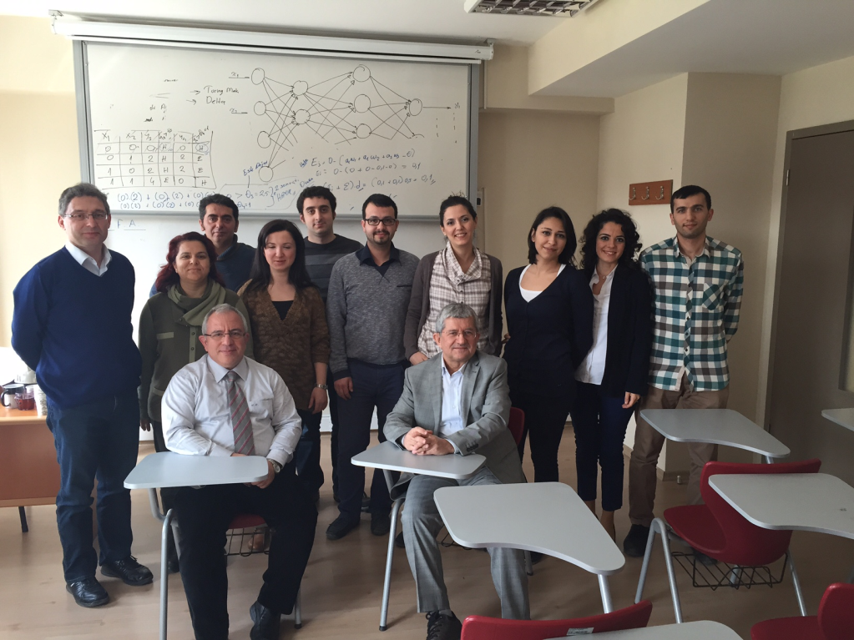
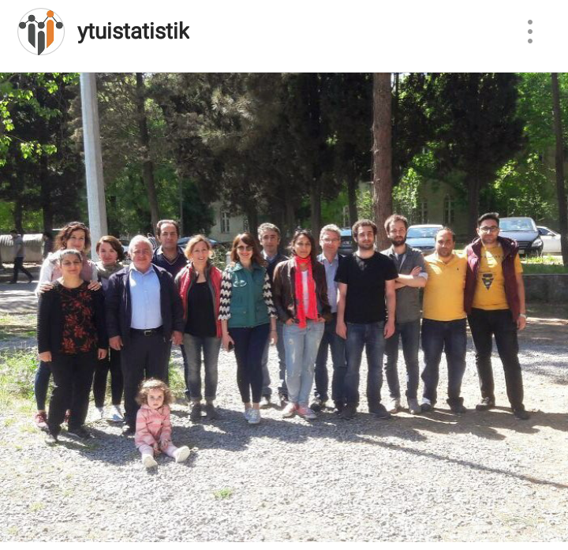
Head of Department Prof. Dr. Gülhayat GÖLBAŞI ŞİMŞEK gulhayat@yildiz.edu.tr https://avesis.yildiz.edu.tr/gulhayat
Deputy Head of Department Prof. Dr. Fatma NOYAN TEKELİ https://avesis.yildiz.edu.tr/fnoyan
Deputy Head of Department Lecturer Dr. Özlem Berak Korkmazoğlu berak@yildiz.edu.tr https://avesis.yildiz.edu.tr/berak
Academic Staff
5 | Professor
6 | Associate Professor
4 | Assistant Professor
1 | Lecturer Dr.
8 | Research Assistant

Slide 4
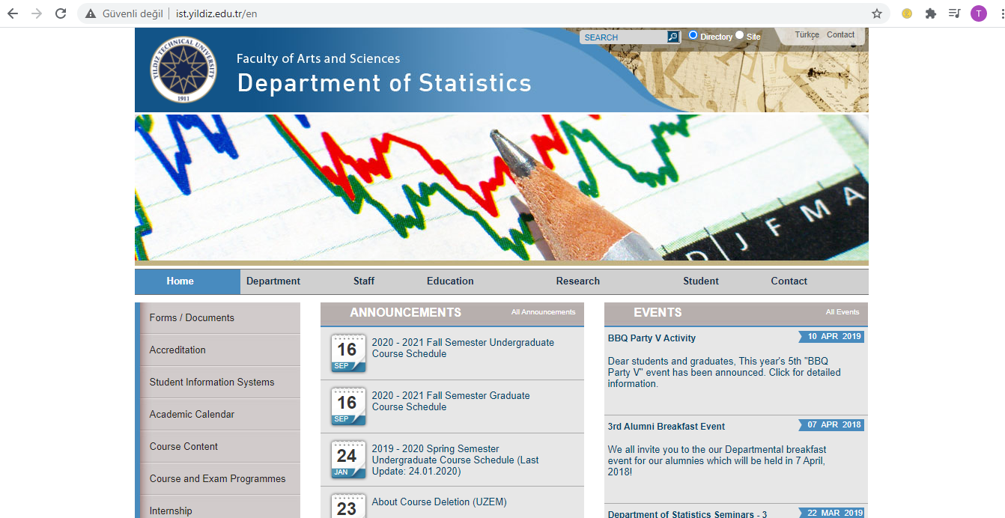
http://www.ist.yildiz.edu.tr/en

Slide 5
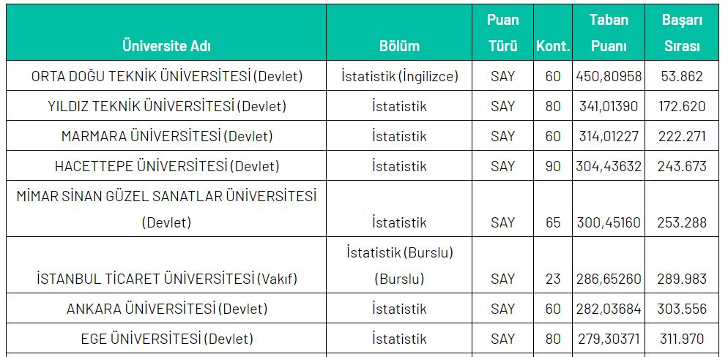
Base scores of Statistics Departments in 2020

Slide 6
Bachelor Curriculum - 1
1.Year - Fall Semester |  |  |  |  |  |  |  | 1.Year - Spring Semester
Code | Title | Lecture | Practical | Lab. | Local Credit | ECTS |  | Code | Title | Lecture | Practical | Lab. | Local Credit | ECTS
IST1131 | Introduction to Probability | 2 | 0 | 0 | 2 | 4 |  | TDB1032 | Turkish language 2 | 2 | 0 | 0 | 0 | 2
IST1141 | Introduction to Statistics | 2 | 0 | 0 | 2 | 5 |  | IST1132 | Probability | 2 | 2 | 0 | 3 | 7
TDB1031 | Turkish Language 1 | 2 | 0 | 0 | 0 | 2 |  | MAT1002 | Mathematics 2 | 4 | 2 | 0 | 5 | 7
MAT1001 | Mathematics 1 | 4 | 2 | 0 | 5 | 7 |  | ENF1170 | Introductory Computer Sciences | 2 | 2 | 0 | 3 | 4
MDB1031 | Advanced English I | 3 | 0 | 0 | 3 | 3 |  | ATA1032 | Principles of Atatürk and History of Modern Turkey II | 2 | 0 | 0 | 0 | 2
ATA1031 | Principles of Atatürk and History of Modern Turkey I | 2 | 0 | 0 | 0 | 2 |  | MDB1032 | Advanced English II | 3 | 0 | 0 | 3 | 3
IST1081 | Introduction to Computer Programming | 3 | 0 | 0 | 3 | 3 |  | IST1142 | Statistics | 3 | 0 | 0 | 3 | 5
MAT1811 | Linear Algebra 1 | 3 | 0 | 0 | 3 | 4
Total: 30 |  |  |  |  |  |  |  | Total: 30
2.Year - Fall Semester |  |  |  |  |  |  |  | 2.Year - Spring Semester
Code | Title | Lecture | Practical | Lab. | Local Credit | ECTS |  | Code | Title | Lecture | Practical | Lab. | Local Credit | ECTS
IST2161 | Professional Englısh 1 | 2 | 0 | 0 | 2 | 2 |  | MAT2412 | Differential Equations | 4 | 0 | 0 | 4 | 5
IST2131 | Computer Programming I | 3 | 0 | 0 | 3 | 3 |  | IST2162 | Professional English 2 | 2 | 0 | 0 | 2 | 2
IST2041 | Business Knowledge for Statistics | 2 | 0 | 0 | 2 | 2 |  | IST2022 | Mathematical Statistics | 2 | 2 | 0 | 3 | 6
IST2081 | Survey Sampling 1 | 3 | 0 | 0 | 3 | 3 |  | IST2252 | Data Analysis | 2 | 0 | 0 | 2 | 3
MAT2001 | Mathematical Analysis 3 | 4 | 2 | 0 | 5 | 7 |  | IST2142 | Database | 3 | 0 | 0 | 3 | 5
IKT1101 | Introduction to Economics 1 | 3 | 0 | 0 | 3 | 6 |  | SEC0001 | Vocational Elective 1-1 | 3 | 0 | 0 | 3 | 5
IST2121 | Introduction to Mathematical Statistics | 2 | 2 | 0 | 3 | 7 |  | SEC0002 | Vocational Elective 2-1 | 2 | 0 | 0 | 2 | 4
Total: 30 |  |  |  |  |  |  |  | Total: 30

Slide 7
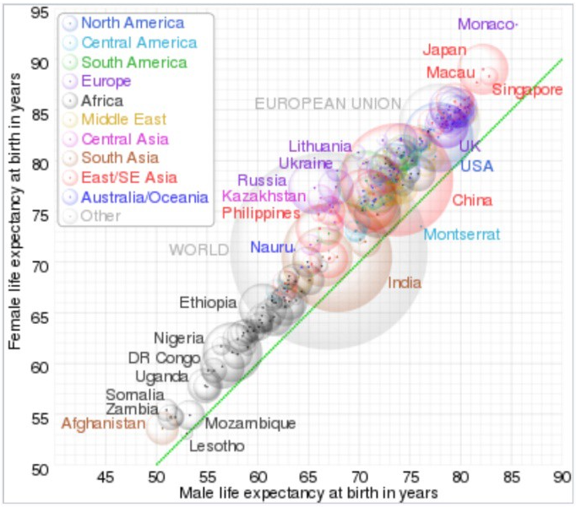
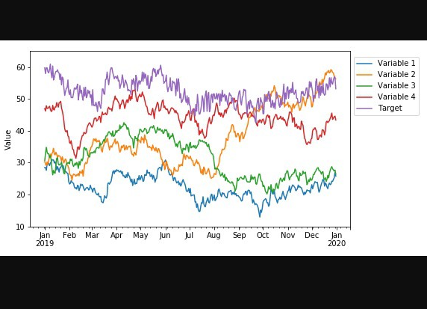
Bachelor Curriculum - 2
3.Year - Fall Semester |  |  |  |  |  |  |  | 3.Year - Spring Semester
Code | Title | Lecture | Practical | Lab. | Local Credit | ECTS |  | Code | Title | Lecture | Practical | Lab. | Local Credit | ECTS
IST3121 | Regression Analysis 1 | 3 | 0 | 0 | 3 | 5 |  | IST3012 | Operations Research 1 | 2 | 2 | 0 | 3 | 5
IST3131 | Research Methods | 2 | 0 | 0 | 2 | 3 |  | IST3142 | Experimental Design | 2 | 2 | 0 | 3 | 6
IST3141 | Nonparametric Statistical Methods | 3 | 0 | 0 | 3 | 4 |  | MDB3032 | Business English | 2 | 0 | 0 | 2 | 2
MDB2051 | Reading and Speaking in English | 2 | 0 | 0 | 2 | 2 |  | SEC0006 | Vocational Elective 5-1 | 2 | 0 | 0 | 2 | 4
IST3011 | Optimization | 2 | 2 | 0 | 3 | 6 |  | SEC0007 | Vocational Elective 6-1 | 3 | 0 | 0 | 3 | 5
SEC0003 | Vocational Elective 3-1 | 2 | 0 | 0 | 2 | 4 |  | SEC0008 | Vocational Elective 7-1 | 2 | 0 | 0 | 2 | 3
SEC0004 | Vocational Elective 4-1 | 2 | 0 | 0 | 2 | 3 |  | SEC0009 | Vocational Elective 7-2 | 2 | 0 | 0 | 2 | 3
SEC0005 | Social Elective 1-1 | 3 | 0 | 0 | 3 | 3
Total: 30 |  |  |  |  |  |  |  | Total: 30
4.Year - Fall Semester |  |  |  |  |  |  |  | 4.Year - Spring Semester
Code | Title | Lecture | Practical | Lab. | Local Credit | ECTS |  | Code | Title | Lecture | Practical | Lab. | Local Credit | ECTS
IST4131 | Econometrics | 3 | 0 | 0 | 3 | 6 |  | IST4122 | Time Series | 3 | 0 | 0 | 3 | 5
IST4111 | Multivariate Statistics 1 | 2 | 2 | 0 | 3 | 6 |  | IST4000 | Graduation Thesis | 0 | 12 | 0 | 6 | 8
SEC0010 | Vocational Elective 8-1 | 2 | 0 | 0 | 2 | 5 |  | SEC0014 | Vocational Elective 10-1 | 3 | 0 | 0 | 3 | 4
SEC0011 | Vocational Elective 8-2 | 2 | 0 | 0 | 2 | 5 |  | SEC0015 | Vocational Elective 11-1 | 2 | 0 | 0 | 2 | 5
SEC0012 | Vocational Elective 9-1 | 2 | 0 | 0 | 2 | 4 |  | SEC0016 | Vocational Elective 11-2 | 2 | 0 | 0 | 2 | 5
SEC0013 | Vocational Elective 9-2 | 2 | 0 | 0 | 2 | 4 |  | SEC0017 | Social Elective 1-2 | 3 | 0 | 0 | 3 | 3
Total: 30 |  |  |  |  |  |  |  | Total: 30

Slide 8
Student Guide
https://www.yildiz.edu.tr/style/img/ytu_ogrenci_rehberi_2019_2020-.pdf

Slide 9
Bologna Information System
http://www.bologna.yildiz.edu.tr

Slide 10
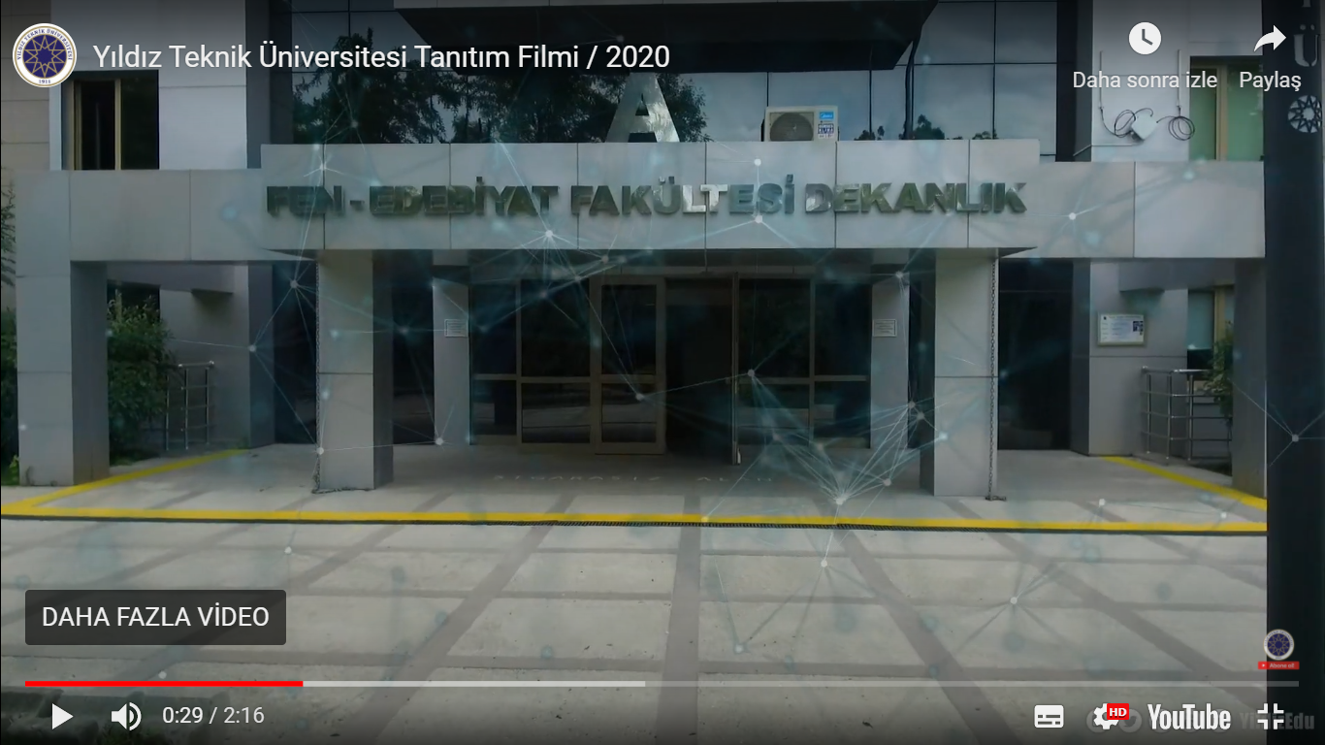
YTU Video
http://www.yildiz.edu.tr/sayfa/ÜNİVERSİTEMİZ/YTÜ-TANITIM-VİDEOSU/101

Slide 11
HIGHER EDUCATION INSTITUTIONS STUDENT DISCIPLINE REGULATION (YÜKSEKÖĞRETİM KURUMLARI ÖĞRENCİ DİSİPLİN YÖNETMELİĞİ)
http://www.ce.yildiz.edu.tr/images/files/disiplin.pdf
Disciplinary Offences and Penalties
(Disiplin Cezaları ve Suçları)
Disciplinary Investigation
(Disiplin Soruşturması)

Slide 12
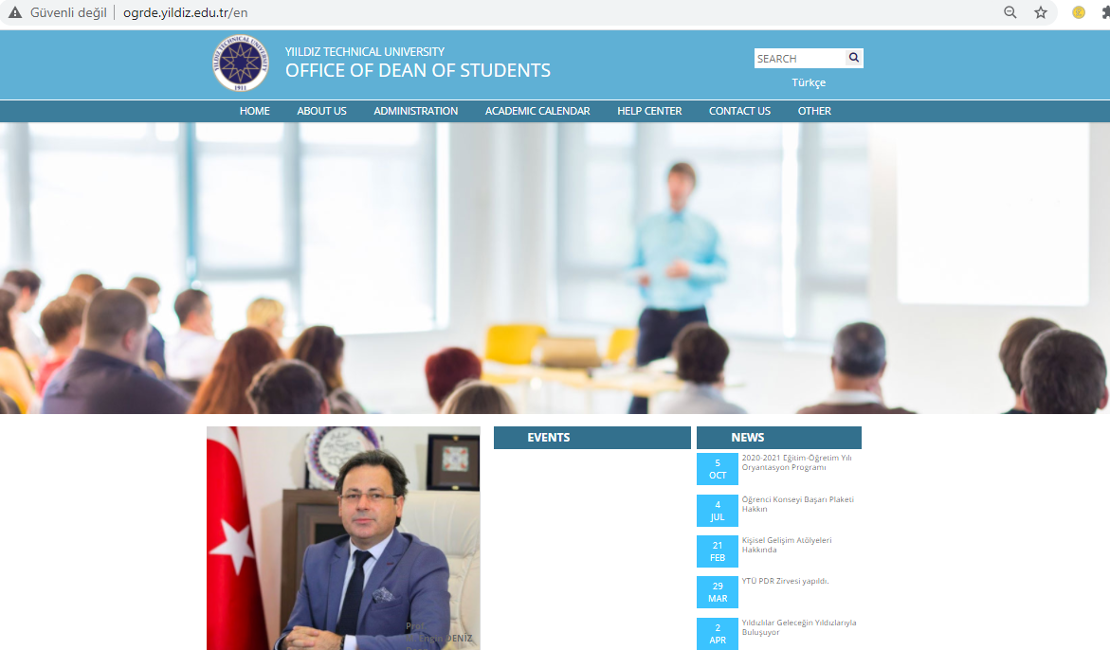
Office of Dean of Students (Öğrenci Dekanlığı)
http://www.ogrde.yildiz.edu.tr/en

Slide 13
Office of Dean of Students (Öğrenci Dekanlığı)
The main purpose of this office is not only to contribute to the academic achievements of you, but also to contribute to your personal, cultural and social development; and to generate a dynamic life in campus by providing fast and effective solutions to the problems that can affect your development and success during your education.

Slide 14
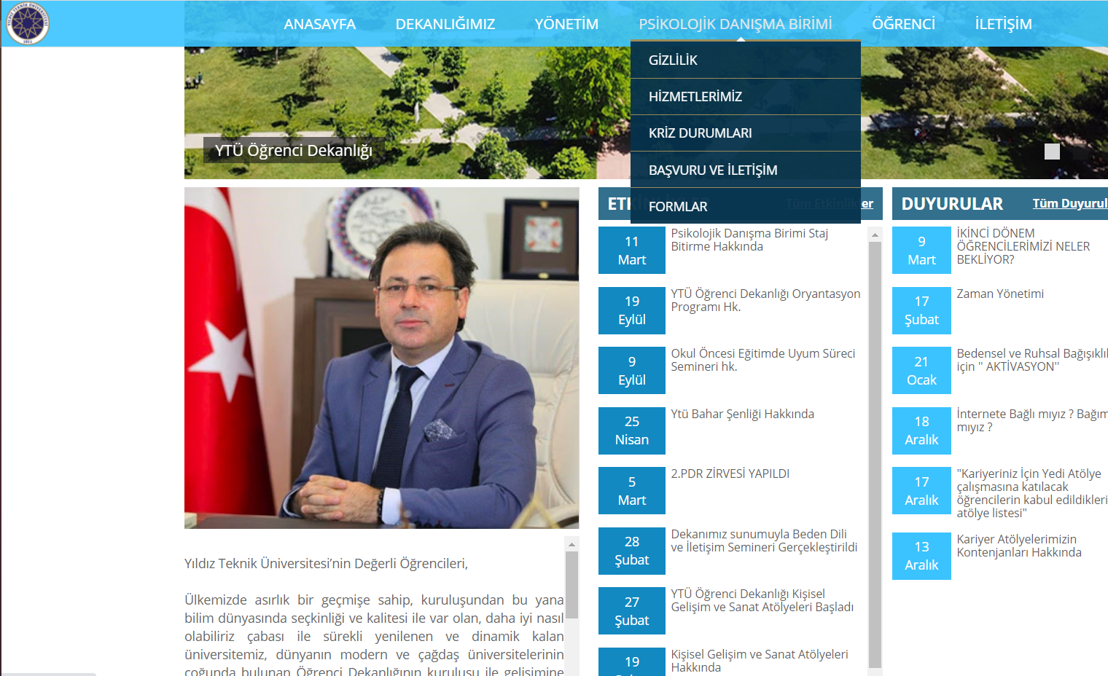
Psychological Counseling Unit (Psikolojik Danışma Birimi)

Slide 15
Promotion Catalogs (Tanıtım Katalogları)
http://www.iletisim.yildiz.edu.tr/

Slide 16
The meanings of the achievement grades
Success Grade | Coefficient
Başarı Notu | Katsayı | Explanation | Açıklama
AA | 4,00 | Excellent | Mükemmel
BA | 3,50 | Very good | Pekiyi
BB | 3,00 | Good | İyi
CB | 2,50 | Average | Orta
CC | 2,00 | Satisfactory | Yeterli
DC | 1,50 | Provisionally Successful | Koşullu Başarılı
DD | 1,00 | Fail | Başarısız
FD | 0,50 | Fail | Başarısız
FF | 0,00 | Fail | Başarısız
F0 | 0,00 | Absent | Devamsız

Slide 17
Qualification Requirements And Regulations
The undergraduate students in this program must be successful in all of the courses with a minimum achievement grade of DC, must have completed at least 240 ECTS credits and have scored a minimum CGPA of 2.00/4.00.
CGPA:
Cumulative Grade Points Average
Kümülatif Not Ortalaması
Also, the students must complete
their compulsory internship within
the designated period of time and
within the scope of necessary
qualifications.

Slide 18
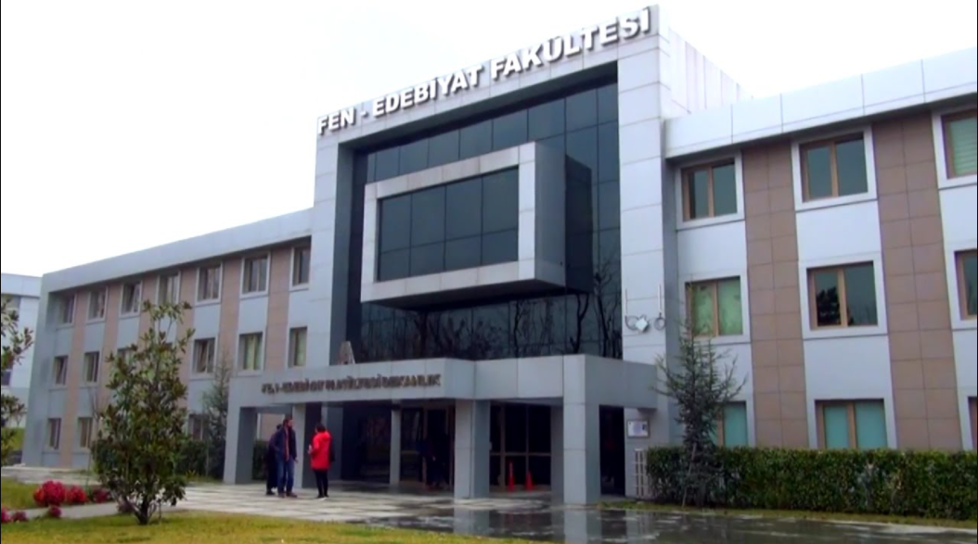
What do we do in the department?
Our offices are in A-Blok
@ Faculty of Arts & Science Building.

Slide 19
What do Statisticans Do?*
Data are not just numbers, but numbers that carry information about a specific setting and need to be interpreted in that setting. With the growth in the use of data comes a growing demand for the services of statisticians, who are experts in the following:
• Producing trustworthy data
• Analyzing data to make their meaning clear
• Drawing practical conclusions from data
*American Statistical Association (ASA)

Slide 20
Examples of Statistics Careers*
Medicine
The search for improved medical treatments rests on careful experiments that compare promising new treatments with the current state of the art. Statisticians work with medical teams to design experiments and analyze the complex data they produce.
Environment Studies of the environment require data on the abundance and location of plants and animals, on the spread of pollution from its sources, and on the possible effects of changes in human activities. The data are often incomplete or uncertain, but statisticians can help uncover their meaning.
Industry The future of many industries and their employees depends on improvement in the quality of goods and services and the efficiency with which they are produced and delivered. Improvement should be based on data, rather than guesswork. More companies are installing elaborate systems to collect and act on data to better serve their customers.
*American Statistical Association (ASA)

Slide 21
Examples of Statistics Careers*
Government Surveys How many people are unemployed this month? What do we export to China, and what do we import? Are rates of violent crime increasing or decreasing? The government wants data on issues such as these to guide policy, and government statistics agencies provide them by surveys of households and businesses.
Market Research Are consumer tastes in television programs changing? What are promising locations for a new retail outlet? Market researchers use both government data and their own surveys to answer questions such as these. Statisticians design the elaborate surveys that gather data for both public and private use.
*American Statistical Association (ASA)

Slide 22
Where Do We Work?
Universities (Academia)
Banks
Research Companies
Insurance Companies
There is nowhere not using Statistics! So, relax!
You will find a job! BUT, make sure which area you
like the most before the graduation.
Public Institutions and Organizations, such as:
http://www.turkstat.gov.tr/Start.do
Notes:
Graduates of the department can find job opportunities in both the private and public sector. They may apply for posts in the Turkish Statistical Institiute, as well as other establishment such as Department of Planning. Other area of work; Research, Finance, Banking, ISE, planning department of the big firm. Thirty percent of our courses are conducted in English enabling our students to develop their language skills and increasing their opportunities to find employment in a variety of different sectors.

Slide 23
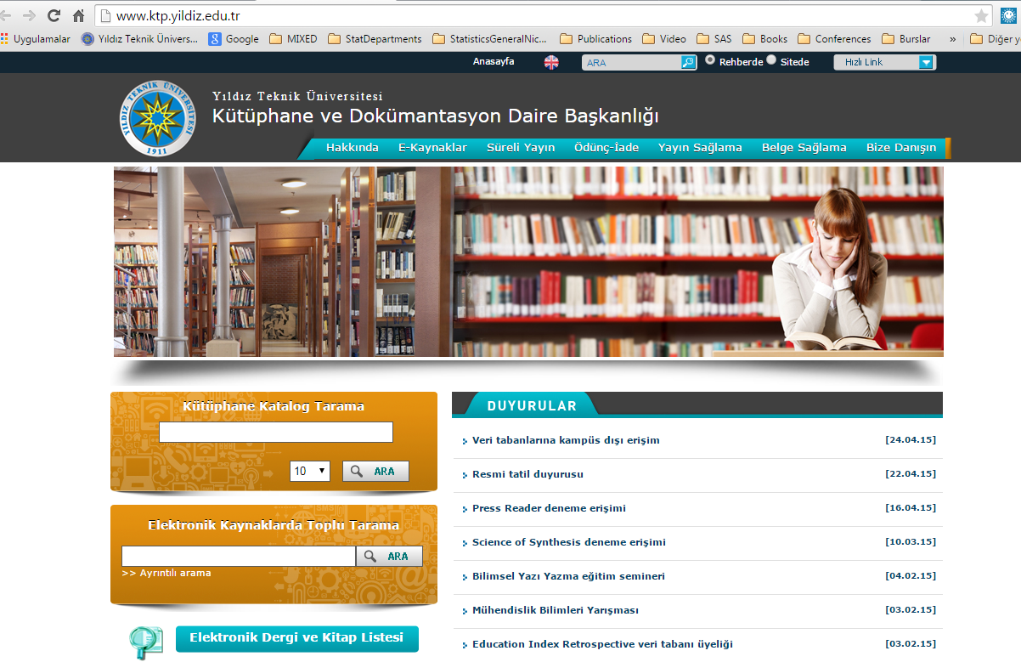
Library and Documentation Department

Slide 24
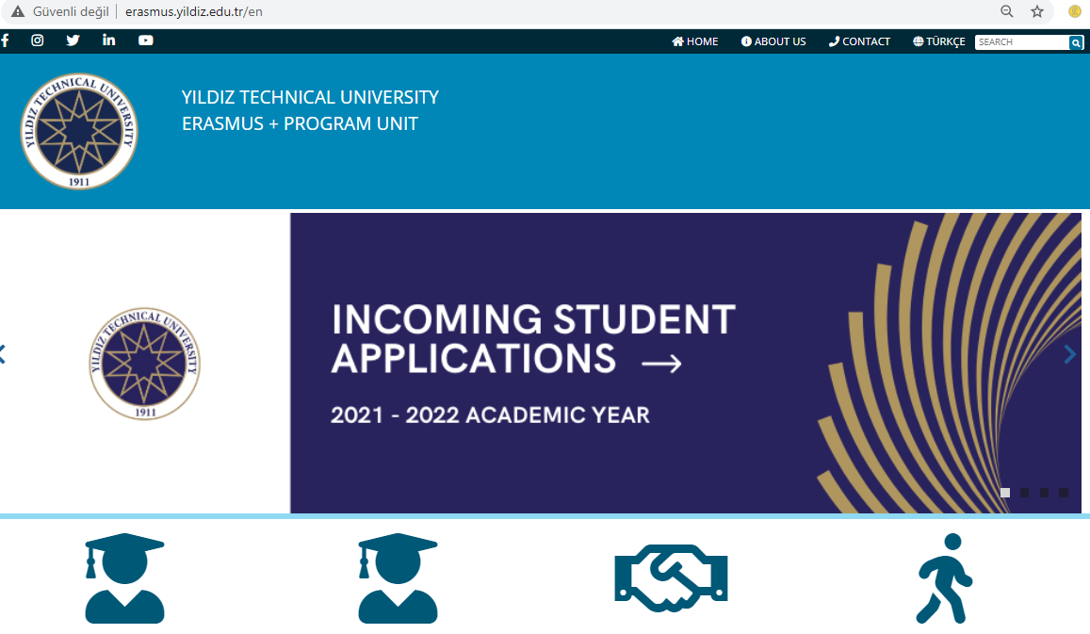

Slide 25
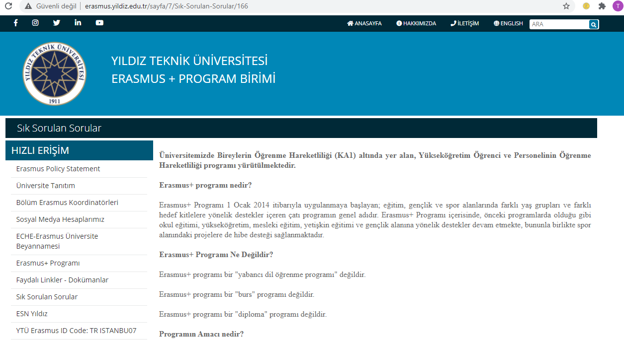
For more detailed information about Erasmus+ program, please click on «Frequently Asked Questions (Sıkça Sorulan Sorular)» on the website.

Slide 26
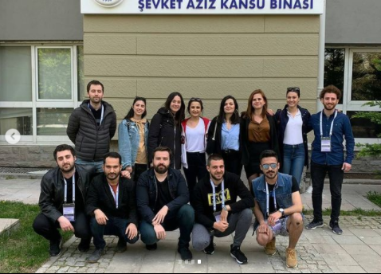
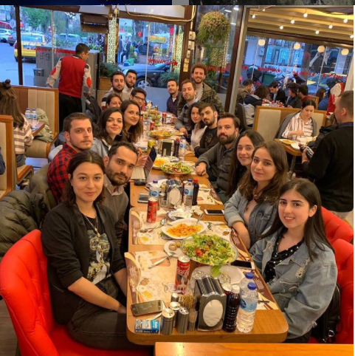
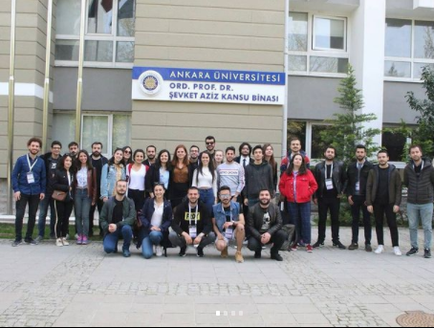
International Statistics Student Colloquium
(Uluslararası İstatistik Öğrenci Kolokyumu)
In this event, statistics students make their own presentations to the students and teaching staff.
Every year, the colloquium is organized in different locations.
For example, YTU organized the colloquium in 2018 and AU organized the colloquium in 2019 (in 2020, the colloquium was not organized because of Covid-19)
Students study on their own researches with their advisor and make a presentation about their topics to the participants.

